Slide 1
This file is an historical remnant. It belongs to the collection Skeptron Web Archive (included in Donald Broady's archive) that mirrors parts of the public Skeptron web site as it appeared on
31 December 2019, containing material from the research group Sociology of Education and Culture (SEC) and the research programme Digital Literature (DL). The contents and file names are unchanged while character and layout encoding of older pages has been updated for technical reasons. Most links are dead. A number of documents of negligible historical interest as well as the collaborators’ personal pages are omitted. The site's internet address was since Summer 1993 www.nada.kth.se/~broady/ and since 2006 www.skeptron.uu.se/broady/sec/.

Slide 2
Formation for the public sphere
– a collective biography
Monica Langerth Zetterman
e-mail:monica.langerth@ped.uu.se
Donald Broady
e-mail:donald.broady@ilu.uu.se
SEC/ILU, Uppsala university
http://www.skeptron.ilu.uu.se/

Slide 3
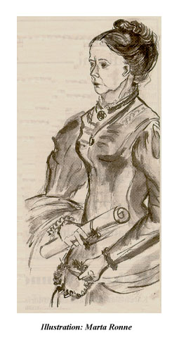
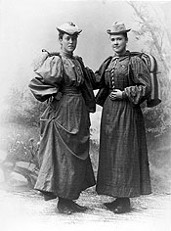
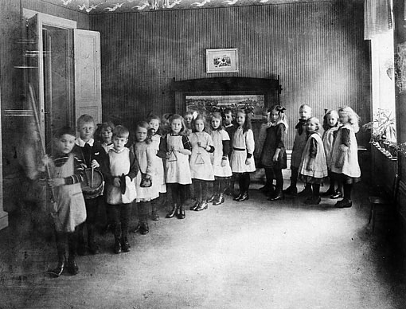
Formation for the Public Sphere - Introduction
Swedish women pioneers
1880-1920
Important progress and innovations in:
culture, philantrophy, education and healt-care.

Slide 4
The concept of symbolic capital
Assets or resources acknowledged by social groups
Relational concept
Distribution of assets
Women invested in many different spheres simultaneously
Map of Stockholm →

Slide 5
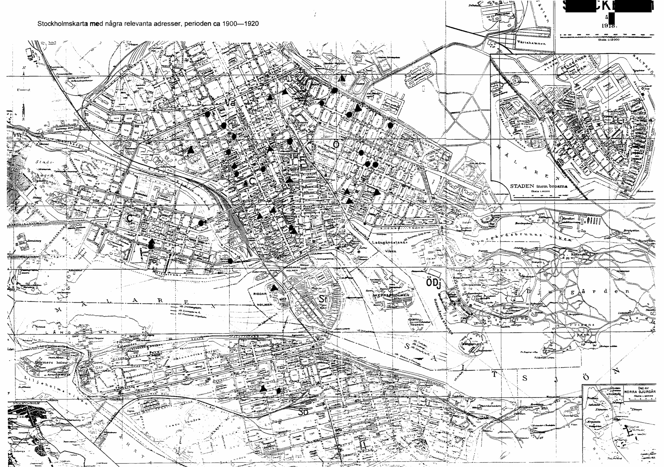
←

Slide 6
Prosopography
Broady, D, “French prosopography: definition and suggested readings”, Poetics, 2002:
comprehensive collection of data
collect information on the same categories for all individuals
analyse strategies and formations of certain social groups
structure of the field

Slide 7
Types of capital
Inherited Capital (social origin)
Educational capital
Social capital
Economic capital
Political and religious capital
Specific symbolic capital

Slide 8
Capital Descriptions
So far >40 comprehensive biographies/capital descriptions
842 less detailed capital descriptions
All capital descriptions include a core dataset of 60 variables encoded according to the TEI DTD with additional tagset Names and Dates.
→

Slide 9
<div type=”cap-desc” id=”HA-023-1”>
<head>Key, Ellen</head>
<div type="bio-data">
<div type=“activity">
<div type=
<persName>
<foreName>Ellen</foreName>
<surname>Key</surname>
</persName>
<div type="occupation">
<head>Profession</head>
<p><rs type="title1“>
Author</rs></p>
</div>
<dateStruct type=“birth”>
<year value="1855">1855</year>
</dateStruct>
… and so on
</div>
</div>
</div>
</div>
←

Slide 10
Capital Descriptions
So far >40 comprehensive biographies/capital descriptions
842 less detailed capital descriptions
All capital descriptions include a core dataset of 60 variables encoded according to the TEI DTD with additional tagset Names and Dates.
→

Slide 11
Conceptual Data Model

Slide 12
TEI example
  <div type="org-cap" org="uniform" sample="complete" part="N" TEIform="div">
  <head TEIform="head">DELTAGANDE I INFORMELLA KVINNLIGA NÄTVERK OCH DELTAGANDE I FÖRENINGAR, SAMMANSLUTNINGAR, STIFTELSER </head>
  - <p TEIform="p">
  <orgName type="informal-network" TEIform="orgName">Uppgift saknas</orgName>
  </p>
  - <p TEIform="p">
  - <orgName type="assoc" reg="UKS" TEIform="orgName">
  <orgType type="student"TEIform="orgType">Uppsala kvinnliga studentförening</orgType>
  </orgName>
  - <orgName type="assoc" reg="ABKF" TEIform="orgName">
  <orgType type="acawom"TEIform="orgType">Akademiskt bildade kvinnor förening</orgType>
  </orgName>
  - <orgName type="assoc" reg="SFSS" corresp=“SAP-ORG-4” TEIform="orgName">
  <orgType type="health"TEIform="orgType">Stockholms Flick- och samskolors sjukhjälpsförening</orgType>
  </orgName>
  - <orgName type="assoc" reg="SKN" corresp=“SAP-ORG-5“ TEIform="orgName">
  <orgType type="womrights"TEIform="orgType">Svenska kvinnors nationalförbund</orgType>
  </orgName>
  - <orgName type="assoc" reg="IDUN" TEIform="orgName">
  <orgType type="womlitt"TEIform="orgType"> Sällskapet Nya Idun </orgType>
  <date value="1914" TEIform="date">invald 1914</date>
  </orgName>

Slide 13
Output (so far)
Applied XSLT to the TEI encoded texts to transform:
→ other TEI/XML
HTML
Excel spreadsheet
SPSS register
SPAD Correspondence Analysis
Browsing and presentation

Slide 14
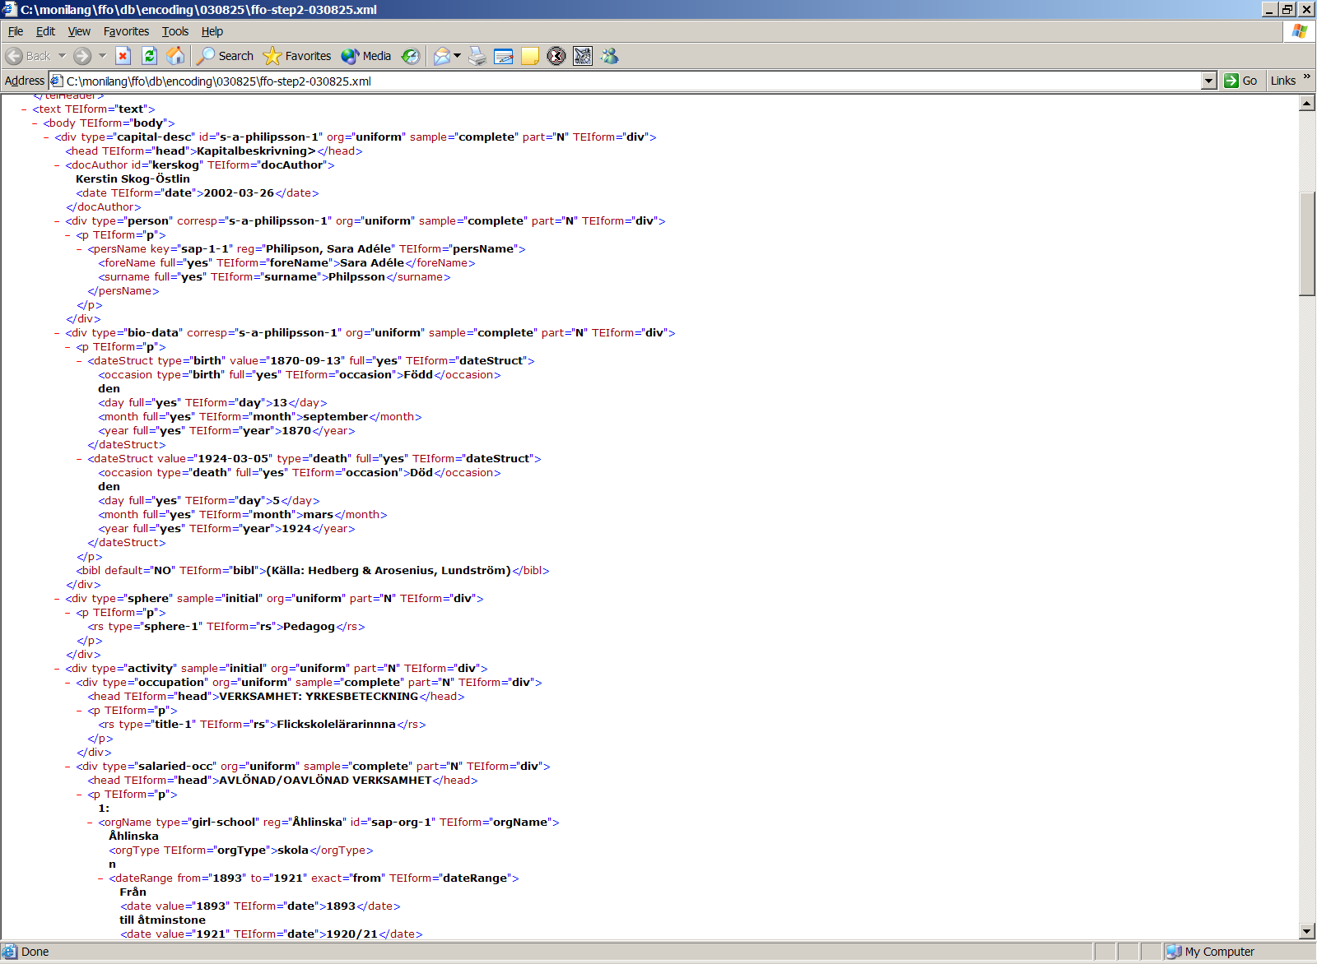
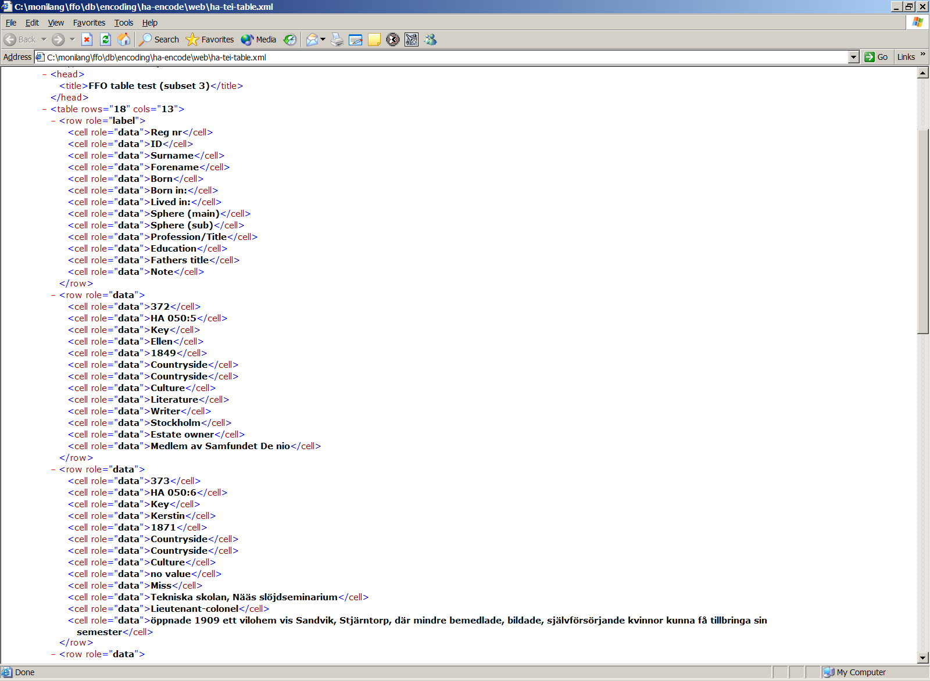
←
←

Slide 15
Output (so far)
Applied XSLT to the TEI encoded texts to transform:
→ other TEI/XML
→ HTML
Excel spreadsheet
SPSS register
SPAD Correspondence Analysis
Browsing and presentation

Slide 16
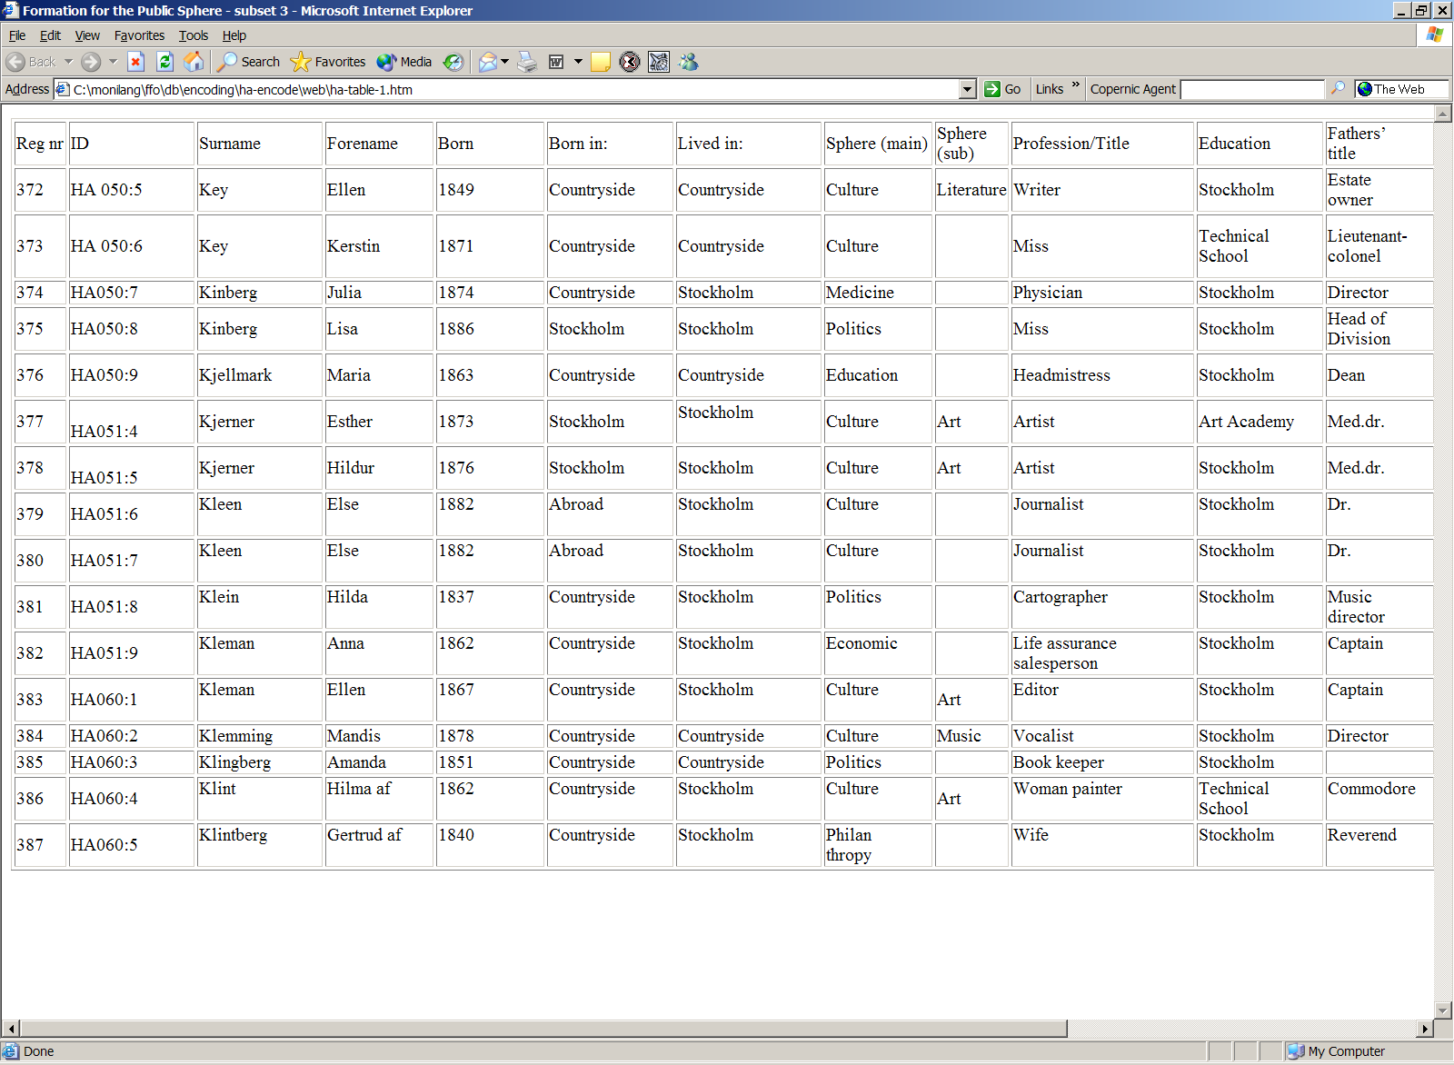
←

Slide 17
Output (so far)
Applied XSLT to the TEI encoded texts to transform:
→ other TEI/XML
→ HTML
→ Excel spreadsheet
SPSS register
SPAD Correspondence Analysis
Browsing and presentation

Slide 18
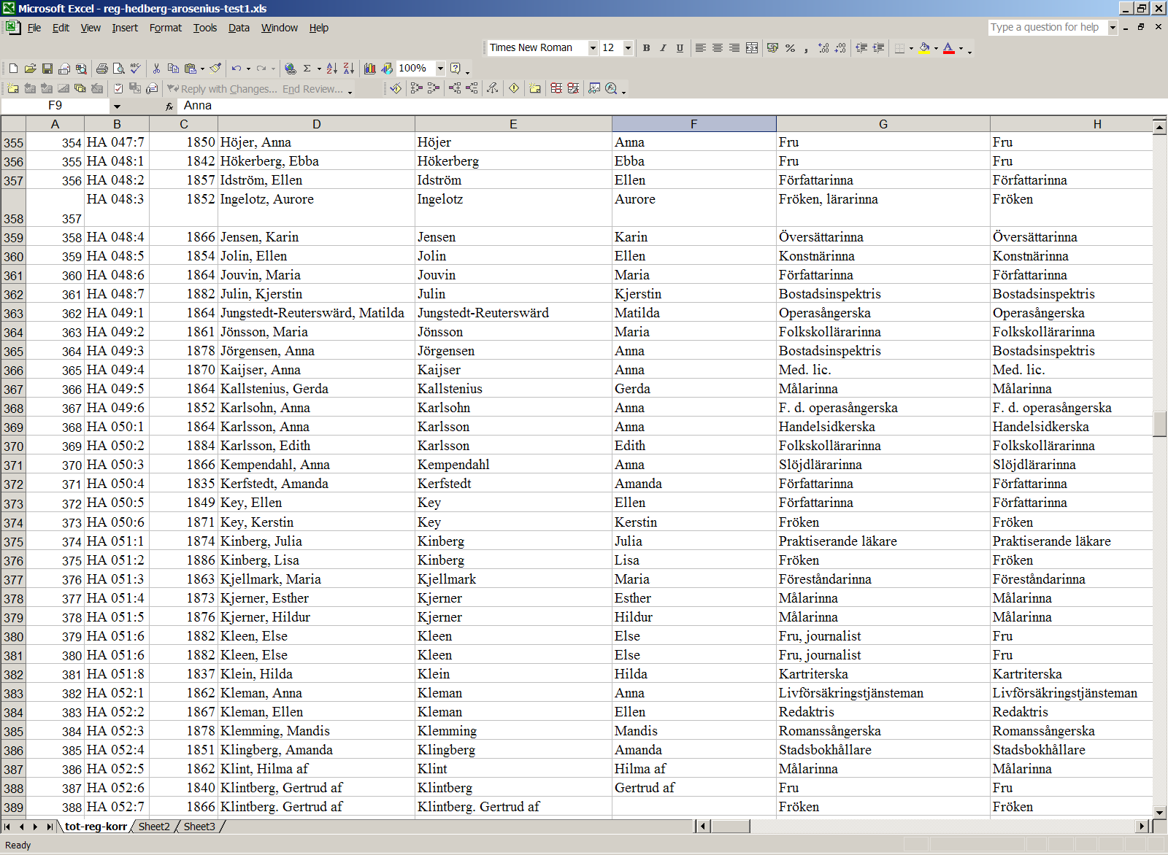
←

Slide 19
Output (so far)
Applied XSLT to the TEI encoded texts to transform:
→ other TEI/XML
→ HTML
→ Excel spreadsheet
→SPSS register
SPAD Correspondence Analysis
Browsing and presentation

Slide 20
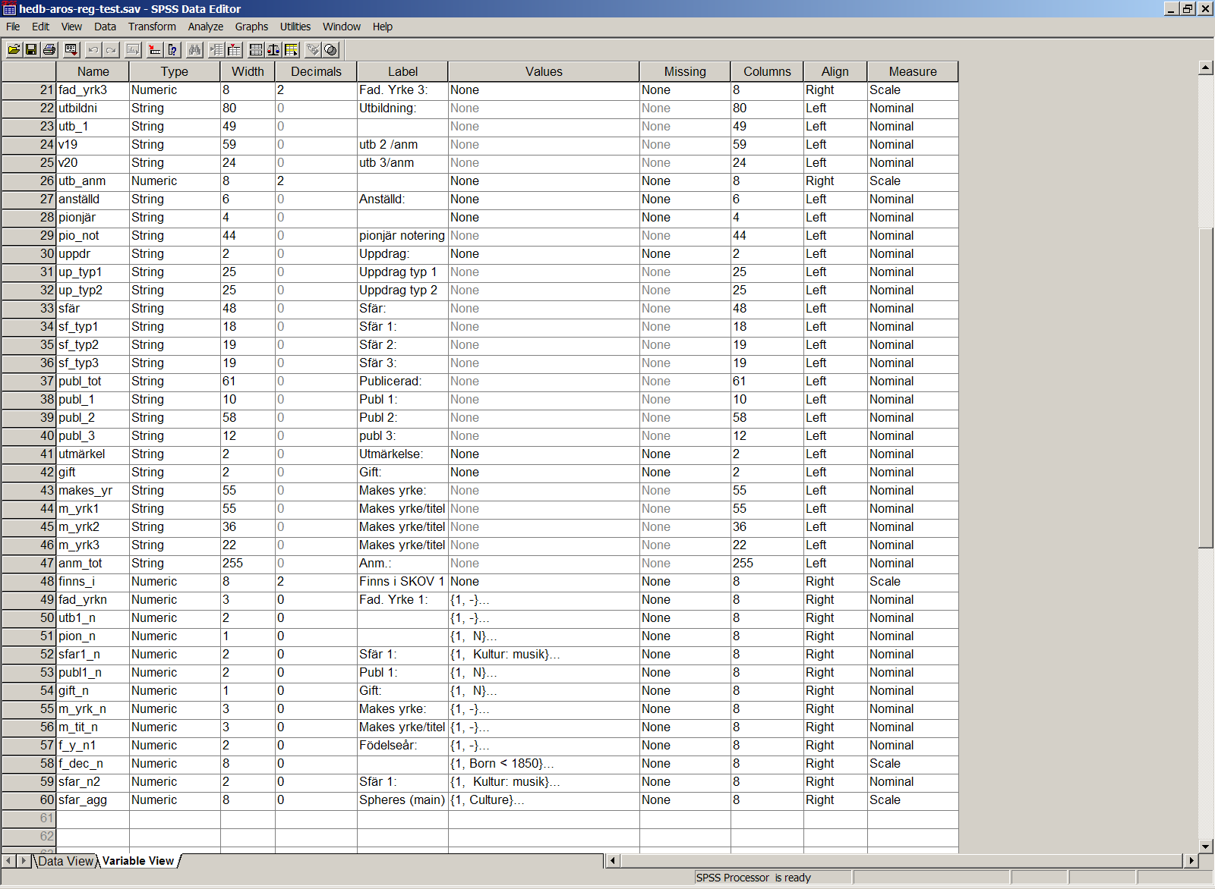
←

Slide 21
Output (so far)
Applied XSLT to the TEI encoded texts to transform:
→ other TEI/XML
→ HTML
→ Excel spreadsheet
→SPSS register
→ SPAD Correspondence Analysis
Browsing and presentation

Slide 22
Variables:
-Education
-Born in
-Birth (decade)
-Main Sphere
-Pioneer
-Married
←

Slide 23
Output (so far)
Applied XSLT to the TEI encoded texts to transform:
→ other TEI/XML
→ HTML
→ Excel spreadsheet
→SPSS register
SPAD Correspondence Analysis
Browsing and presentation

Slide 24
